Slide 1
Yvonne Suessmuth, PhD
Postdoctoral Fellow
Emory Transplant Center, Atlanta, GA
The 12th Joint Annual Congress of the American Society of Transplant Surgeons
and The American Society of Transplantation
I have no financial relationships to disclose within the past 12 months relevant to my presentation
My presentation does not include discussion of off-label or investigational use
I do not intend to reference unlabeled/unapproved uses of drugs or products in my presentation.

Slide 2


Comparison of Viral Immunity in Stable Renal Allograft Recipients Treated with
Belatacept or Tacrolimus
Yvonne Suessmuth PhD, PW Thompson; C Breeden; B Johnson; R Jones; LA Stempora; J Cheeseman; J Joseph; B Begley; S Thomas; AD Kirk; K Newell; CP Larsen; AK Mehta
Emory Transplant Center
Emory Transplant Center
Notes:
Hello my name is Yvonne Suessmuth, I am from the Emory Transplant Center. First I would like to thank the organizers for the opportunity to present our data here today. My talk is entitled “Comparison of viral immunity in stable renal allograft recipients treated with Belatacept or Tacrolimus”

Slide 3
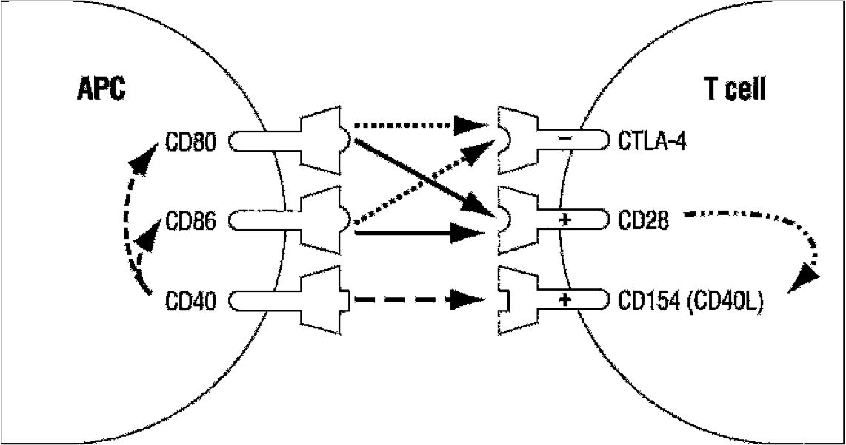
Belatacept
Newly approved high-affinity CTLA4Ig variant
  Blocks interaction of CD28 with CD80/86
  Inhibits T cell proliferation and differentiation
  Improved GFR in belatacept groups vs. CSA
  Improved metabolic control
Increased incidence of EBV related PTLD
Very little data on impact of belatacept on protective immunity
X
X
Larsen et al. Am J Transplant 2006; 6: 876 – 883.
Notes:
Belatacept is a costimulation blockade-based agent.
As a high affinity variant of CTLA4Ig, it blocks the interaction of the costim molecule CD28 on T cells with its ligands CD80 and 86 on APCs, thereby inhibiting T cell proliferation and differentiation.
Patients treated with Belatacept have shown improved GFR compared to Cyclosporine A treated patients as well as improved metabolic control.
On the other hand an increased incidence of EBV related PTLD was reported.
So far very little data on the impact of Belatacept on protective immunity has been accumulated.

Slide 4
In vitro treatment of PBMCs with Belatacept does not inhibit EBV specific memory
Mehta AK, et al. ATC 2011
Notes:
As our group presented last year at this meeting:
In vitro treatment of PBMCs with Belatacept does not lead to an inhibition of EBV specific memory as you can see here in the comparison of various Belatacept concentrations.

Slide 5
In vitro treatment of PBMCs with Belatacept does not inhibit EBV specific memory
Lack of data on viral specific protective immunity in patients treated with belatacept
Mehta AK, et al. ATC 2011
Notes:
Still data on viral specific protective immunity in patients treated with Belatacept is lacking.

Slide 6
Study Design and Patient populations
Subjects were enrolled from existing immune monitoring protocols at Emory University
Peripheral blood samples were collected at a single timepoint
Phenotypic and functional analysis of peripheral blood lymphocytes were performed using rationally-designed and validated flow cytometric panel
  10 healthy volunteers
  10 transplant recipients (>6mos s/p renal allograft) on stable dose of Belatacept, MMF, and prednisone
  10 transplant recipients (>6mos s/p renal allograft) on stable dose of Tacrolimus, MMF, and prednisone
Notes:
For this cross sectional study we enrolled subjects from existing immune monitoring protocols at Emory University.
We took blood samples at a single timepoint and analysed the cells phenotypically and functionally with validated flow cytometric panels.
Our comparison groups include
- 10 healthy volunteers
- 10 kidney recipients >6months post-transplant on a stable dose of belatacept
- 10 and kidney recipients >6mos post-transplant on a stable dose of tacrolimus.

Slide 7
Subject Characteristics
Group | Treatment | Number (n) | Median Age (range) | Sex (M/F) | # months s/p txp | Seropositive (EBV/CMV)
Healthy Controls | None | 10 | 43.8 (29- 55) | 5 / 5 | n/a | 9/5
Tacrolimus (>6m s/p kidney txp) | Tacrolimus + MMF + Prednisone | 10 | 49.3 (34- 66) | 6 / 4 | 51.7 (6- 120) | 10/7
Belatacept (>6m s/p kidney txp) | Belatacept + MMF +Prednisone | 10 | 51.1 (34- 63) | 4 / 6 | 92.2 (44- 128) | 9 / 7
Notes:
Subject characteristics were matched according to age, sex and seropositivity for EBV and CMV.

Slide 8
Subject Characteristics
Group | Treatment | Number (n) | Median Age (range) | Sex (M/F) | # months s/p txp | Seropositive (EBV/CMV)
Healthy Controls | None | 10 | 43.8 (29- 55) | 5 / 5 | n/a | 9/5
Tacrolimus (>6m s/p kidney txp) | Tacrolimus + MMF + Prednisone | 10 | 49.3 (34- 66) | 6 / 4 | 51.7 (6- 120) | 10/7
Belatacept (>6m s/p kidney txp) | Belatacept + MMF +Prednisone | 10 | 51.1 (34- 63) | 4 / 6 | 92.2 (44- 128) | 9 / 7
Notes:
The most important difference between the treatment groups is that Belatacept patients have been farther out from transplant compared to Tacrolimus patients.
We are not sure what this means yet, but keep this difference in mind when I show you our results.

Slide 9
Methods
PBMCs were rested 8h in 10% RPMI, then stimulated for 12h with either:
  CMV pp65 PepMix = 15-mers overlapping by 11 aa covering the length of pp65
  EBV BZLF PepMix = 15-mers overlapping by 11 aa covering the length of BZLF
  EBV Peptide pool = Peptides from several EBV proteins but restricted by HLA types
Cells were then stained for the following markers:
FITC | PE | PerCP-Cy5.5 | APC | PE-Cy7 | Alexa 700 | V450 | Qdot 655 | APC-Cy7 | Pac Orange
CD28 | CD27 | IFNγ | TNFα | CD4 | CD8 | CD3 | CD45RA | CCR7 | CD14/CD20 +Live/Dead
MIP1β | CD107a | IFNγ | TNFα | IL-2 | CD8 | CD3 | CD45RA | CCR7 | CD14/CD20 +Live/Dead
MIP1β | CD154 | IL-17 | CCR5 | CD4 | CD8 | CD3 | CD45RA | CCR7 | CD14/CD20 +Live/Dead
Notes:
For our assay we used frozen PBMCs which were rested for 8h in 10% RPMI after which they were stimulated for 12h with either a CMV peptide mix or one of two EBV peptide mixes.
The cells were then stained for the following markers you can see in this table.

Slide 10
Methods
PBMCs were rested 8h in 10% RPMI, then stimulated for 12h with either:
  CMV pp65 PepMix = 15-mers overlapping by 11 aa covering the length of pp65
  EBV BZLF PepMix = 15-mers overlapping by 11 aa covering the length of BZLF
  EBV Peptide pool = Peptides from several EBV proteins but restricted by HLA types
Cells were then stained for the following markers:
FITC | PE | PerCP-Cy5.5 | APC | PE-Cy7 | Alexa 700 | V450 | Qdot 655 | APC-Cy7 | Pac Orange
CD28 | CD27 | IFNγ | TNFα | CD4 | CD8 | CD3 | CD45RA | CCR7 | CD14/CD20 +Live/Dead
MIP1β | CD107a | IFNγ | TNFα | IL-2 | CD8 | CD3 | CD45RA | CCR7 | CD14/CD20 +Live/Dead
MIP1β | CD154 | IL-17 | CCR5 | CD4 | CD8 | CD3 | CD45RA | CCR7 | CD14/CD20 +Live/Dead
Notes:
In my talk today however I will be concentrating on the top panel which contains costim molecules CD27, CD28, cytokines IFNg and TNFa as well as memory subset markers CD45RA and CCR7.

Slide 11
Gating Strategy
Lymphocytes
Singlets
Live CD3 cells
Notes:
Our gating strategy involves gating for Lymphocytes and singlet cells. With the help of a live/dead stain and a CD14/CD20 dump gate we then gate for live Tcells.

Slide 12
Gating Strategy
Lymphocytes
Singlets
Live CD3 cells
CD4 vs CD8 cells
Notes:
These are then further divided into CD4 and CD8 cells

Slide 13
Gating Strategy
Lymphocytes
Singlets
Live CD3 cells
CD4 vs CD8 cells
Notes:
Which we can then stain for either surface markers like CD27/CD28 or intracellular cytokines like TNFa /IFNg.

Slide 14
Belatacept treated patients show no difference in TNFα/IFNγ production in CD4 cells compared to Tacrolimus
Belatacept patient
CD4 EBV stimulated
Notes:
In our first experiment we looked at TNFa/IFNg production in overall CD4 cells in response to either EBV or CMV stimulation.
On the right hand side you can see a representative flow plot showing TNFa and IFNg production. I will be concentrating on TNFa/IFNg double producing cells.
As you can see in the bar graph no significant difference was found between Belatacept and Tacrolimus treated patients in response to either stimulus.

Slide 15
Belatacept treated patients show no difference in TNFα/IFNγ production in CD8 cells compared to Tacrolimus
Belatacept patient
CD8 EBV stimulated
Belatacept patient
CD8 CMV stimulated
Notes:
Belatacept treated patients also show no significant difference in frequency of TNFalpha/IFNgamma positive CD8 cells when compared to the Tacrolimus group.

Slide 16
Belatacept treated patients show no difference in TNFα/IFNγ production in CD8 cells compared to Tacrolimus
Belatacept patient
CD8 EBV stimulated
Belatacept patient
CD8 CMV stimulated
Notes:
We did notice increased TNFa/IFNg production in Tacrolimus patients in response to CMV stimulation but this did not reach statistical significance

Slide 17
Belatacept patients show more TNFα/IFNγ production in Central Memory cells but lower in Naïve CD8 cells in response to EBV stimulation
p= 0.028
p= 0.054
TCM
Naive
CCR7
TEM
TEMRA
CD45RA
Notes:
Because different viruses can influence the memory subset distribution of cytokine producing cells, we also examined the different memory subsets of CD8 cells separately.

Slide 18
Belatacept patients show more TNFα/IFNγ production in Central Memory cells but lower in Naïve CD8 cells in response to EBV stimulation
p= 0.028
p= 0.054
TCM
Naive
CCR7
TEM
TEMRA
CD45RA
Notes:
In Central Memory cells we found an increased frequency of TNFa/IFNg producing cells in Belatacept patients in response to EBV stimulation

Slide 19
Belatacept patients show more TNFα/IFNγ production in Central Memory cells but lower in Naïve CD8 cells in response to EBV stimulation
p= 0.028
p= 0.054
TCM
Naive
CCR7
TEM
TEMRA
CD45RA
Notes:
While Tacrolimus patients show increased TNFa/IFNg production in Naïve cells.

Slide 20
Belatacept patients show more TNFα/IFNγ production in Central Memory cells but lower in Naïve CD8 cells in response to EBV stimulation
p= 0.028
p= 0.054
TCM
Naive
CCR7
TEM
TEMRA
CD45RA
Notes:
We did not see any significant difference between treatment groups in Effector Memory and Effector Memory RA subsets.
And as you can see Healthy control cells showed equal distribution of double producing cells among all memory subsets

Slide 21
In response to CMV stimulation Tacrolimus treated patients show higher production of TNFα/IFNγ in all CD8 Memory subsets
p=0.009
TCM
Naive
CCR7
TEM
TEMRA
CD45RA
Notes:
In response to CMV stimulation Tacrolimus patients showed increased TNFa/IFNg producing cells uniformely in all memory subsets compared to the Belatacept group.
Healthy cells again show a mostly uniform distribution of double producers across all memory subsets
Naïve cells: Bela CMV vs Tac CMV significant diff p=0.0092 (**)
TCM: bela and Tac are not significantly different p=0.106
TEM cells are not different p=0.1061
TEMRA cells are not different p=0.3434

Slide 22
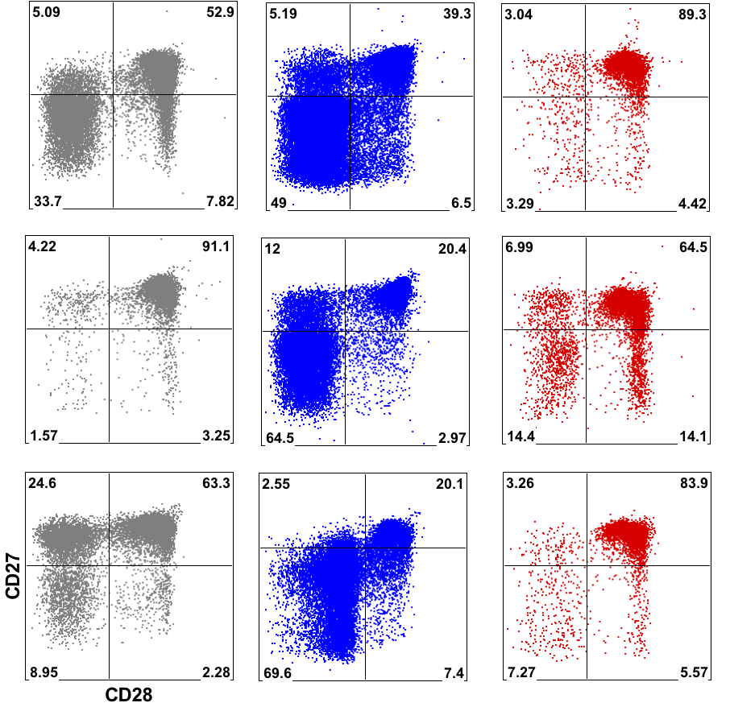
Belatacept treated patients show a robust trend towards increased CD27lo/CD28lo cells
Healthy
Belatacept
Tacrolimus
Notes:
When analysing Healthy controls, Belatacept and Tacrolimus patients for the expression of costim molecules CD27/CD28

Slide 23
Belatacept treated patients show a robust trend towards increased CD27lo/CD28lo cells
Healthy
Belatacept
Tacrolimus
Notes:
We found that belatacept patients show high frequencies of CD27lo/CD28lo cells…….

Slide 24
Belatacept treated patients show a robust trend towards increased CD27lo/CD28lo cells
Healthy
Belatacept
Tacrolimus
Notes:
……Compared to both Healthy controls and Tacrolimus treated patients

Slide 25
Increased CD27lo/CD28lo cell numbers in Belatacept patients do not correlate with increased TNFα/IFNγ double producing cells in this population
EBV
CMV
Notes:
To further explore this difference we looked at TNFa/IFNg production in this cell subset.

Slide 26
Increased CD27lo/CD28lo cell numbers in Belatacept patients do not correlate with increased TNFα/IFNγ double producing cells in this population
EBV
CMV
Notes:
Despite increased CD27/cD28lo cells, Belatacept patients do not show increased TNFa/IFNg production in these cells compared to the Tacrolimus group in response to either EBV stimulation…..

Slide 27
Increased CD27lo/CD28lo cell numbers in Belatacept patients do not correlate with increased TNFα/IFNγ double producing cells in this population
EBV
CMV
Notes:
….or CMV stimulation

Slide 28
Conclusions
Belatacept treatment does not appear to significantly impact virus-specific immune function as compared to Tacrolimus treatment.
  Differences in TNFα/IFNγ production are possibly due to the difference in cohorts but need further investigation
Differences observed between healthy controls and treated patients in memory subsets suggest that immunosuppressive agents influence how viral-specific memory is maintained
Increased numbers of late differentiated cells (CD27lo/CD28lo) in Belatacept patients do not coincide with significantly decreased viral- specific immunity in these patients.
Notes:
In conclusion Belatacept treatment does not appear to significantly impact virus-specific immune function as compared to Tacrolimus treatment.
The differences in TNFa/IFNg production between Belatacept and Tacrolimus patients are possibly due to the difference in cohorts with respect to the time passed since transplant but warrants further investigation.
Differences observed between healthy controls and treated patients in memory subsets suggest that immunosuppressive agents influence how viral-specific memory is maintained
Increased numbers of late differentiated cells in Belatacept patients do not coincide with significantly decreased viral-specific immunity in these patients.
Change to alpha nd gamma

Slide 29
Future Plans
Enroll further 10 early post transplant Belatacept and 10 late post transplant Tacrolimus treated patients to ensure better comparison between the groups.
Monitor patients longitudinally in the CTOT10 Trial comparing long-term treatment with Belatacept to Tacrolimus
Notes:
In order to be better able to compare Tacrolimus and Belatacept treated patients we aim to further enroll 10 early post transplant Belatacept patients and 10 late post transplant Taccrolimus patients
We will also monitor different treatment groups of patients during the CTOT10 trial, a longitudinal study comparing Belatacept and Tacrolimus treatment. This trial will be carried out in collaboration with UAB and UCSF.

Slide 30


Acknowledgments
Special Thanks To:
Christian P Larsen
Aneesh K Mehta
Allan D Kirk
Kenneth Newell
Peter Thompson
Linda Stempora
Cindy Breeden
Brandi Johnson
He Xu
ETC Biorepository
Rachelle Jones
Stephanie Monday
Kendra Bryant
Jennifer Cheeseman
ETC Clinical Research Coordinators
Elizabeth Begley
Shine Thomas
Elizabeth Ferry
The Patients!
Grant support: A portion of this work was performed as part of the Clinical Trials in Organ Transplantation, supported by the National Institute of Allergy and Infectious Diseases.
Notes:
With this I would like to thank my supervisors and colleagues in the lab as well as the staff of the Transplant center Biorepository, the Clinical coordinators and of course the patients whithout who this study would not have been possible.
I am happy to take any questions.
Metabolic controls: better control of cholesterol and blood pressure and blood sugar

